Slide 1
Advances in Data Science and Architecture
PROJECT REPORT
TEAM : D-PREDICTORS
Apoorva Verma
Bhushan Patil
Gaurav Saxena
Shruti Ranjalkar

Slide 2
Application of Data Sciences in Insurance Industry:
Discover policy termination patterns and profiles of customer who leave for a deeper understanding of why they left
Predict future customer value to determine if you want to retain an at-risk customer, and at what cost
Predict what offer or service would prevent a customer from switching insurers, and what price will cover your risk of insuring that customer for another term
Project Problem Statement:
To introduce a model that estimates the probability of the policy along with
the cost a customer would buy. Prediction would be based on customer’s shopping history.
Aim is to develop a model that achieves high accuracy and good recall rate.

Slide 3
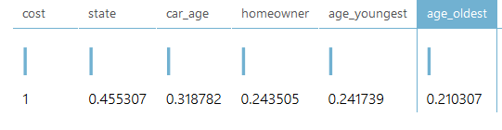
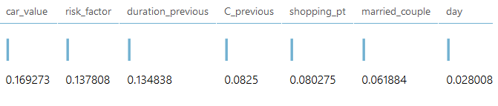
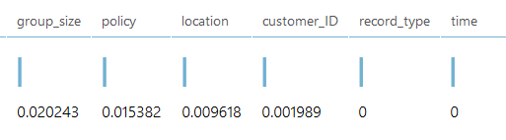
Observed correlation between the features
Derived few new features: Age_Diff, Mean_Age, Old_Person, FamilyPlan, newCar, oldCar

Slide 4
Handling NA values
There are three approaches to handle N/A value records. 1. Removing the n/a value records
2. Replacing the n/a values with the mean
3. Replacing the n/a values with zero
Our consideration-
For model 1: N/A value records were not considered.
For model 2: N/A values were replaced with zero

Slide 5
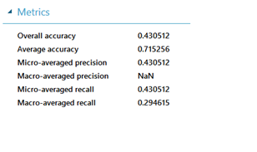
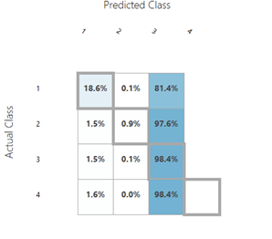
Model with some Data Preparation
Developed the model using Multiclass Decision Jungle Classifier using Microsoft ML Azure tool without any data preparation and feature selection.

Slide 6
Findings
The classes are imbalanced
Without proper data preparation and features from the session history the model is not able to predict with precision.
The features derived also seems unimportant
The model always predicts class 3

Slide 7
Data Split:
Split the data into test train and validation set. 30% of training data is test data set and 30% is validation set.

Slide 8
Policy Prediction

Slide 9
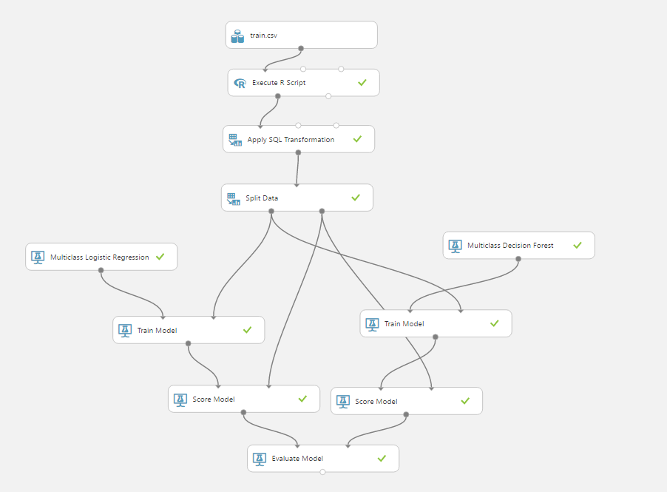
Classification- Approach 1:
‘Multiclass Logistic Regression’ Algorithm
‘Multiclass Decision Forest’ Algorithm
:

Slide 10
Implementation of model:
Data split into 50:30:20 ratio
Splitting mode: Split Rows
Fraction of rows in the first output of dataset: 0.7
Randomized Split: Yes
Parameter Tuning - Multiclass Logistic Regression:
Parameters:
Create Trainer Mode: Single Parameter
Optimization Tolerance: 1E-07
L1 Regularization Weight: 2
L2 Regularization Weight: 2
Memory size for L- BFGS: 20
Allow unknown Categorical Values: Yes

Slide 11
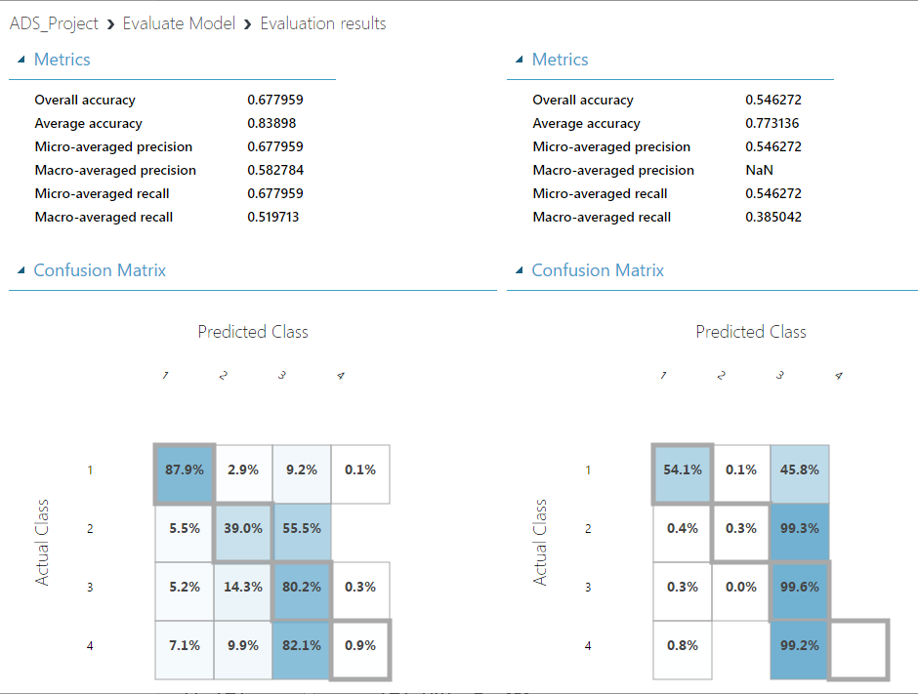
Parameter Tuning - Multiclass Decision Forest:
Resampling Method: Replicate
Create trainer mode: Single Parameter
No. of Decision trees: 10
Maximum depth of the decision trees: 32
No. of random splits as per node: 90
Minimum number of samples per leaf node: 1
Performance of the model:

Slide 12
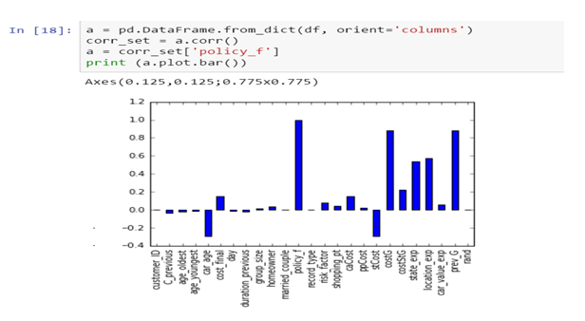
Feature Engineering For Policy Prediction
Previous Visited Policy
Mean of Cost per policy and State
Pattern of Policy per State (Mean of Policy per State).
Pattern of Policy per location (Mean of Policy per Location).
Pattern of Policy per Car_Value (Mean of Policy per Car_Value).
High Co-relation found between cost per policy and previous policy.

Slide 13
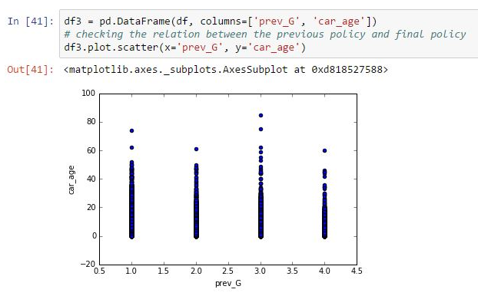
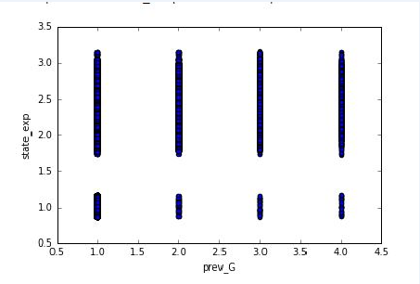
Classification Approach 2
Feature Selection for Policy prediction:
- Married_Couple, Home_Owner, Risk_Factor, C_Previous, Previous_Policy (prev_G), Car_Value_Exp, Location_Exp, State_Exp, Car_Age

Slide 14
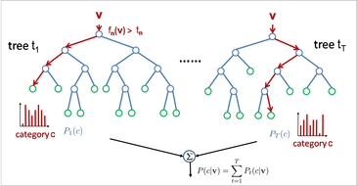
Classification Model: ‘Multiclass Decision Forest’ Algorithm
The algorithm works by building multiple decision trees and then voting on the most popular output class.
Voting is a form of aggregation, in which each tree in a classification decision forest outputs a non-normalized frequency histogram of labels.
The aggregation process sums these histograms and normalizes the result to get the “probabilities” for each label.
The trees that have high prediction confidence will have a greater weight in the final decision of the ensemble.

Slide 15
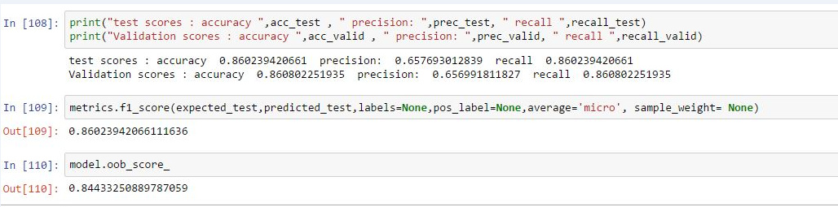
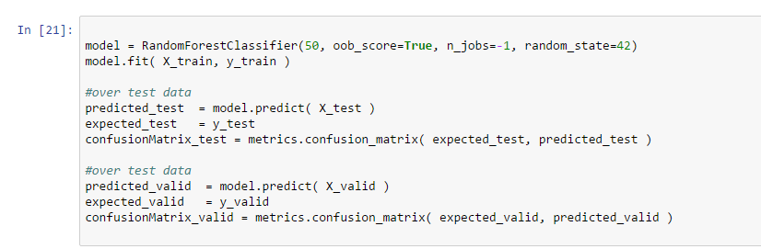
Model:
Random Forest Multiclass-Classifier
Bagging
Model Fitting
After Tuning the Parameters of Random Forest: Number of Trees: 50, N_Jobs=-1 and random_state=42 we achieved test scores:
Accuracy 91%, Precision: 89%, recall: 91% and f1-Score: 91%

Slide 16
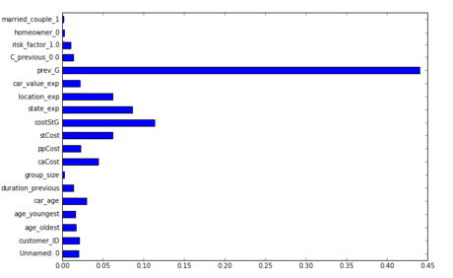
Feature Importance:

Slide 17
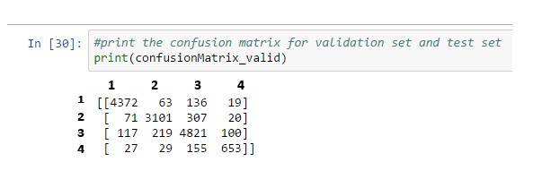
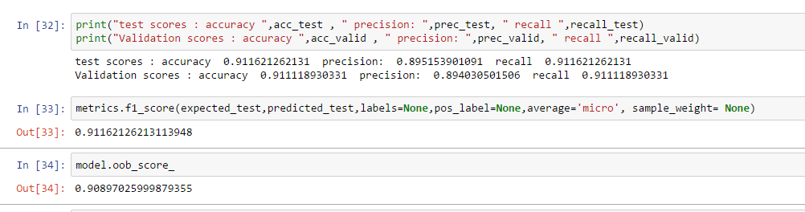
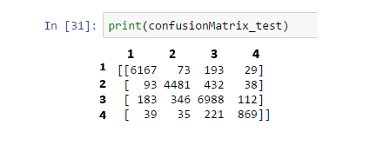
On the Validation set after feature selection:
On the test separated data:

Slide 18
Price Prediction

Slide 19
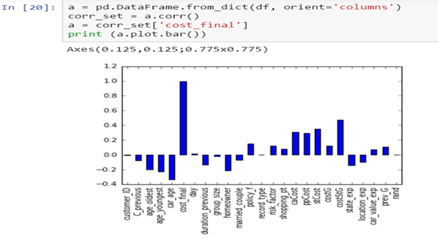
Feature Engineering For Cost Prediction
Previous visited cost and policy.
The Policy predicted by the Final Model.
For every Policy Mean Value of Cost per State.
Mean Value of Cost per State.
Mean Value of Cost per Policy.
Mean Value of Cost per car age
For every Customer Id Mean Value of Cost per
person (transformed using the group_size)

Slide 20
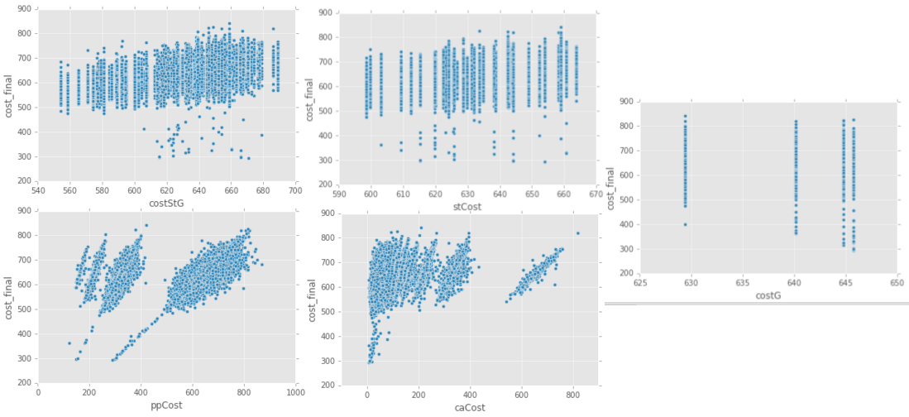
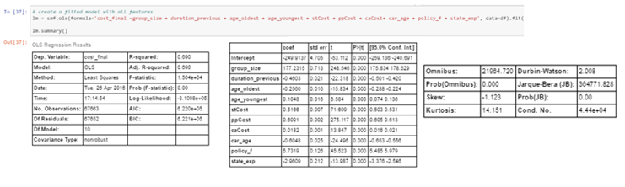
Analysis
Feature Selection:
- Applied linear regression of Statsmodels recursively to get least AIC and BIC

Slide 21
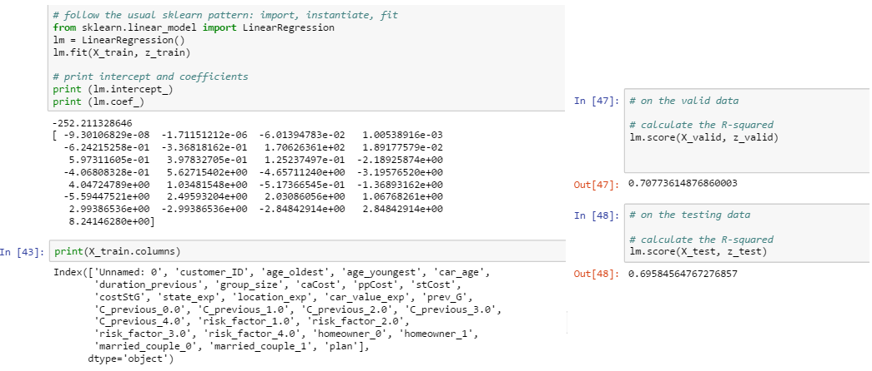
Without Feature Selection, we got the following regresssion model which gave R-Squarred of 0.70 on validation set and 0.69 on testing Set.
But AIC and BIC in that case was 6.536 which was high penalty.
When fitting models, it is possible to increase the likelihood by adding parameters, but doing so may result in overfitting. Both BIC and AIC resolve this problem by introducing a penalty term for the number of parameters in the model

Slide 22
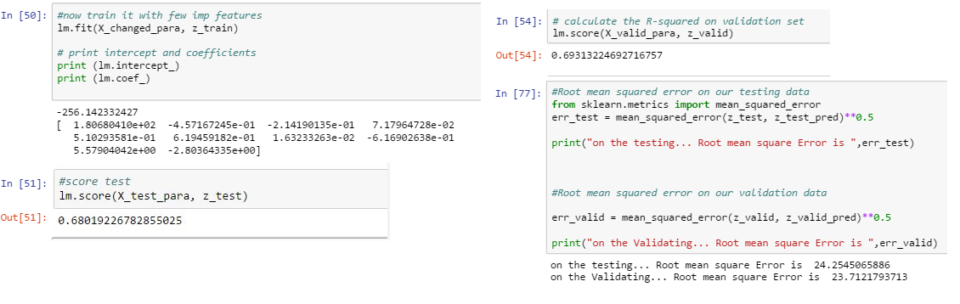
Implemented feature selection as interpreted by AIC and BIC of Statsmodels and build the final model. The Akaike information criterion (AIC) and the Bayesian information criterion (BIC) are based on the log-likelihood of number of parameters. Both measures introduce a penalty for model complexity, but the AIC penalizes complexity less severely than the BIC.
- Achieved a linear regression model which gave a root mean square error of 24.

Slide 23
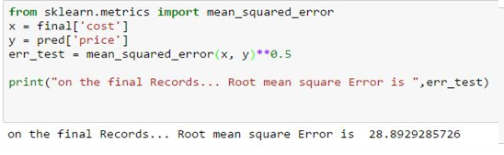
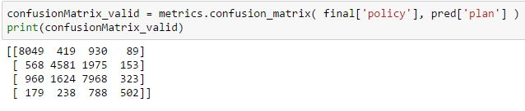
Results on Final Test Data
Accuracy: 71.9%
Recall: 71.9%
F- Measure: 71.9%
Root Mean Square Error: 28.89
Confusion Matrix

Slide 24
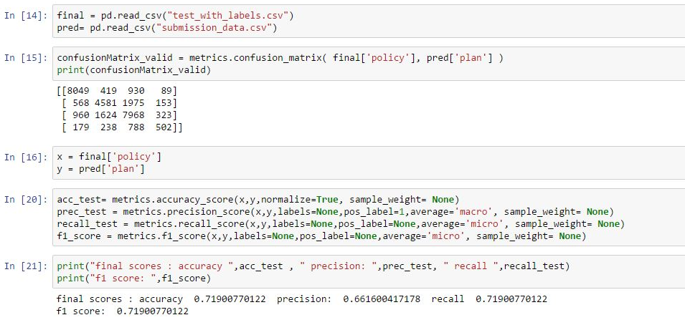
Results on Final Test data

Slide 25
Thank You..!

